Slide 1
Ancient Greek for Everyone: A New Digital Resource for Beginning Greek
2013 edition
Wilfred E. Major
wmajor@lsu.edu

Slide 2
Ancient Greek for Everyone
This class
practice with the Greek alphabet
names from Classical Athenian inscriptions

Slide 3
Ancient Greek for Everyone
When Athenian men turned 18, they enrolled in military training, after which they were eligible for military service until they were 60 years old. As trainees, they were called ἔφηβοι (ephebes).
This reading comes from part of a public monument for a class of these trainees, sort of a list of graduates. This particular list dates from the 320’s BC.
First listed are λοχαγοί (captains), who led units during the second year of training. The list gives their names followed by their fathers’ names (the normal way to name a male Greek citizen).
Notes:
Timothy F. Winters "Using Inscriptions in Elementary Greek," Classical Journal 98 (2003), pp. 289-294.

Slide 4
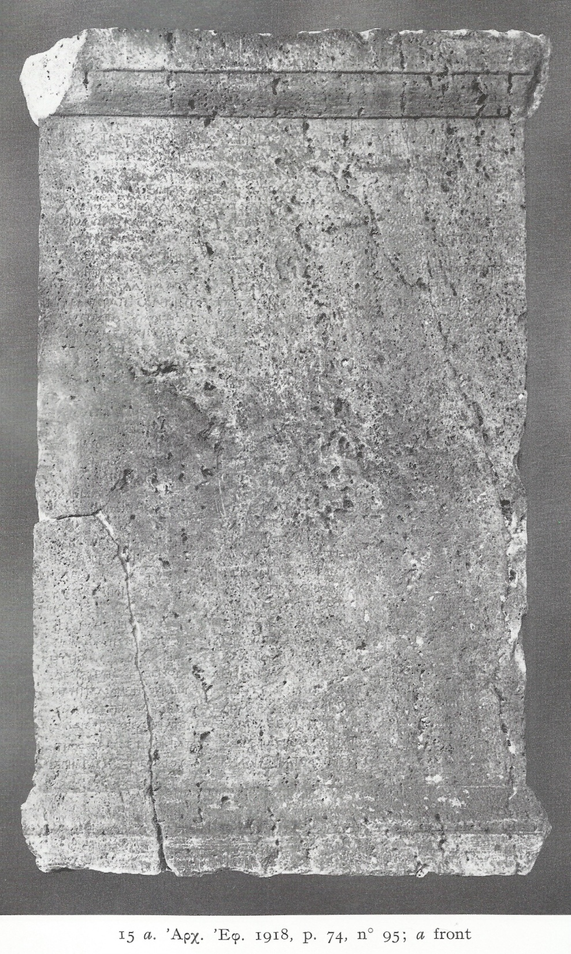
Ancient Greek for Everyone
Λ Ο Χ Α Γ Ο Ι
Ἡγέστρατος Κλείππου, Ἁγνίας Μακαρτάτου, Πασιφῶν Παντήνορου
Ἀρχέπολις Παντήνορος, Παράμυθος Ἀντιγένου, Σωσίστρατος
Σωσιστράτου, Λυσανίας Μόλωνος, Δωσίθεος Ἀντιγένου, Φορύσκος
Τιμοκράτου, Σωσικλῆς Σωσιστράτου, Τιμήσιος Σημωνίδου.
O. W. Reinmuth.
The Ephebic Inscriptions of the Fourth Century B.C. (Mnemosyne,. Suppl. 14). Leiden, Brill, 1971. Nr. 15
plate XVII
Notes:
O. W. Reinmuth. The Ephebic Inscriptions of the Fourth Century B.C. (Mnemosyne,. Suppl. 14). Leiden, Brill, 1971. Nr. 15
The numbers on the left of are line numbers assigned by scholars to the inscription. […] indicate gaps or damage to the stone which makes the letters unrecoverable.

Slide 5
Ancient Greek for Everyone
Λ Ο Χ Α Γ Ο Ι
Ἡγέστρατος Κλείππου, Ἁγνίας Μακαρτάτου, Πασιφῶν
Παντήνορος
Ἀρχέπολις Παντήνορος, Παράμυθος Ἀντιγένου, Σωσίστρατος
Σωσιστράτου, Λυσανίας Μόλωνος, Δωσίθεος Ἀντιγένου,
Φορύσκος
5 Τιμοκράτου, Σωσικλῆς Σωσιστράτου, Τιμήσιος Σημωνίδου.
Notes:
O. W. Reinmuth. The Ephebic Inscriptions of the Fourth Century B.C. (Mnemosyne,. Suppl. 14). Leiden, Brill, 1971. Nr. 15
The numbers on the left of are line numbers assigned by scholars to the inscription. […] indicate gaps or damage to the stone which makes the letters unrecoverable.

Slide 6
Ancient Greek for Everyone
Athens had long been divided into ten tribes (φυλαί). This particular list comes from the tribe Leontis (Λεοντίς).
In the democracy, the φυλαί were further divided into δῆμοι (demes, voting districts in the democracy), and so in this list, the ἔφηβοι are grouped under the name of their δῆμος.
As for the λοχαγοί, the names of the ἔφηβοι themselves consist of their names, followed by their fathers’ names (the normal way to name a male Greek citizen).
Notes:
Timothy F. Winters "Using Inscriptions in Elementary Greek," Classical Journal 98 (2003), pp. 289-294.

Slide 7
Ancient Greek for Everyone
Φρεάριοι
Ἀλκίμαχος Καλλιμάχου
Διόδωρος Καλλιμάχου
Πασιφῶν Παντήνορος
10 Ἀρχέπολις Παντήνορος
Ἕρμιππος Πυθέου
Εὔπολις Καλλιάδου
Ξενοκράτης Ἀντιρήτου
Σώστρατος Φιλοκήδου
15 Ἀρχιάδης Ἀρχίππου
Θρασυκλῆς Θράσωνος
Πυθόδωρος Δημοκλέους
Σμικρίας Ἐπι[— — —ο]υ
Notes:
O. W. Reinmuth. The Ephebic Inscriptions of the Fourth Century B.C. (Mnemosyne,. Suppl. 14). Leiden, Brill, 1971. Nr. 15
The numbers on the left of are line numbers assigned by scholars to the inscription. […] indicate gaps or damage to the stone which makes the letters unrecoverable.

Slide 8
Ancient Greek for Everyone
Ὑβάδαι
20 Μενεστρατίδης Ἱπποστράτου
Λύκαιος Λυκαίου
Φρύνιχος Φρυναίου
Ἡγίας Ἡγίου
Ἀπολλόδωρος Λυσιστράτου
Notes:
O. W. Reinmuth. The Ephebic Inscriptions of the Fourth Century B.C. (Mnemosyne,. Suppl. 14). Leiden, Brill, 1971. Nr. 15
The numbers on the left of are line numbers assigned by scholars to the inscription. […] indicate gaps or damage to the stone which makes the letters unrecoverable.

Slide 9
Ancient Greek for Everyone
25 Χολλεῖδαι
Λυσίστρατος Λυσικράτους
Φί[․․․]ος Αἰσχύνου
Ἀμύντης Σωδάμου
Ναῦσις Γνάθωνος
Notes:
O. W. Reinmuth. The Ephebic Inscriptions of the Fourth Century B.C. (Mnemosyne,. Suppl. 14). Leiden, Brill, 1971. Nr. 15
The numbers on the left of are line numbers assigned by scholars to the inscription. […] indicate gaps or damage to the stone which makes the letters unrecoverable.

Slide 10
Ancient Greek for Everyone
30 Ἑκαλεῖς
Λυσιφῶν Φιλίσκου
Πήληκες
Ἱεροκλῆς Φείδωνος
Φιλῖνος Χαιρεστράτου
Notes:
O. W. Reinmuth. The Ephebic Inscriptions of the Fourth Century B.C. (Mnemosyne,. Suppl. 14). Leiden, Brill, 1971. Nr. 15
The numbers on the left of are line numbers assigned by scholars to the inscription. […] indicate gaps or damage to the stone which makes the letters unrecoverable.

Slide 11
Ancient Greek for Everyone
35 Κήττιοι
Λυσίστρατος Εὐξένου
Ἀμφιτελίδης Φιλοκράτου
Σμίκυθος Ξενοκλέους
Σωσίστρατος Σωστράτου
40 Τιμόστρατος Τιμοκράτου
Ἐπικράτης Σπουδίου
Notes:
O. W. Reinmuth. The Ephebic Inscriptions of the Fourth Century B.C. (Mnemosyne,. Suppl. 14). Leiden, Brill, 1971. Nr. 15
The numbers on the left of are line numbers assigned by scholars to the inscription. […] indicate gaps or damage to the stone which makes the letters unrecoverable.

Slide 12
Ancient Greek for Everyone
col.II.6
Ποτάμιοι ὑπένερθεν
Παράμυθος Ἀντιγένου
Ἐπικράτης Ἀριστοκράτου
10 Σκαμβωνίδαι
Δωσίθεος Ἀντιγένου
Ταυρέας Αἰσίμου
Ποτάμιοι καθύπερθεν
Δημοφάνης Ἀριστοφάνου
Notes:
O. W. Reinmuth. The Ephebic Inscriptions of the Fourth Century B.C. (Mnemosyne,. Suppl. 14). Leiden, Brill, 1971. Nr. 15
The numbers on the left of are line numbers assigned by scholars to the inscription. […] indicate gaps or damage to the stone which makes the letters unrecoverable.

Slide 13
Ancient Greek for Everyone
15 Αἰθαλίδαι
Ἐξώπιος Φαιδρίου
Ποτάμιοι Δειραδιῶται
Πύρρος Πανγκλέους
Φιλόφρων Πανγκλέους
20 [․․․․]μων Ξενοκλέους
Εὔανδρος Εὐάνδρου
Σωσιγένης Σ̣ώ̣σου̣
Notes:
O. W. Reinmuth. The Ephebic Inscriptions of the Fourth Century B.C. (Mnemosyne,. Suppl. 14). Leiden, Brill, 1971. Nr. 15
The numbers on the left of are line numbers assigned by scholars to the inscription. […] indicate gaps or damage to the stone which makes the letters unrecoverable.

Slide 14
Ancient Greek for Everyone
Σουνιεῖς
Ἡγέστρατος Κλείππου
25 Σωσικλῆς Σωσιστράτου
Σωσίστρατος Σωσιστράτου
Τιμήσιος Σημωνίδου
Ναυσίφιλος Κίμωνος
Διονύσιππος Εὐαγγέλου
30 Μειδωνίδης Περικλέους
Ἀρχέδειπνος Νικοδήμου
Θάλλιππος Εὐαγγέλου
Δημοφῶν Εὐξένου
Notes:
O. W. Reinmuth. The Ephebic Inscriptions of the Fourth Century B.C. (Mnemosyne,. Suppl. 14). Leiden, Brill, 1971. Nr. 15
The numbers on the left of are line numbers assigned by scholars to the inscription. […] indicate gaps or damage to the stone which makes the letters unrecoverable.

Slide 15
Ancient Greek for Everyone
Δειραδιῶται
35 Λυσανίας Μόλωνος
Λευκονοῆς
Φορύσκος Τιμοκράτους
Δήμαρχος Ἀριστάνδρου
Θαρρέας Σατύρου
40 Ξαιρεφῶν Καλλιστράτου
Καλλίστρατος Σωτέλου
Notes:
O. W. Reinmuth. The Ephebic Inscriptions of the Fourth Century B.C. (Mnemosyne,. Suppl. 14). Leiden, Brill, 1971. Nr. 15
The numbers on the left of are line numbers assigned by scholars to the inscription. […] indicate gaps or damage to the stone which makes the letters unrecoverable.

Slide 16
Ancient Greek for Everyone
col.III.6
ἐξ Οἴου
Ἁγνίας Μακαράτου
Στράτων Στρατωνίου
10 Εὐπυρίδαι
Εὐκτίμενος Εὐκτιένου
Κολωνῆς
Αἰσχύλος Πρωτομάχου
Θεόδωρος Ἀμφιμάχου
Notes:
O. W. Reinmuth. The Ephebic Inscriptions of the Fourth Century B.C. (Mnemosyne,. Suppl. 14). Leiden, Brill, 1971. Nr. 15
The numbers on the left of are line numbers assigned by scholars to the inscription. […] indicate gaps or damage to the stone which makes the letters unrecoverable.

Slide 17
Ancient Greek for Everyone
The Athenians also commemorated their soldiers when they fell in battle. Like the Vietnam memorial in Washington D.C., the public monuments listed the names of the fallen soldiers. The names of the soldiers are organized by the ten tribes (φυλαί), but, unlike on other monuments (including the ephebic lists), they do not give demes, fathers’ names or any indication of social status. In death, all citizens are equal.
The Athenians dedicated these types of monuments at a public funeral, delivered eulogies, and recited the names of the dead. In reading the names of these fallen warriors today, you keep them alive as the Athenians once did.
Notes:
Timothy F. Winters "Using Inscriptions in Elementary Greek," Classical Journal 98 (2003), pp. 289-294.

Slide 18
Ancient Greek for Everyone
This particular list of names comes from a monument commemorating casualties from several battles c. 425-23 BC.
Chunks of the monument are missing or damaged, but this section lists casualties from the tribe Antiochis, including those from battles at Potidea and Amphipolis.
Notice that at this time Ε was used for both Ε/ε and Η/η.
The name of Antiphanes was inserted later into a blank spot on the list. The carving is different and his name alone has an Η, as was the practice with the alphabet later.
Notes:
Timothy F. Winters "Using Inscriptions in Elementary Greek," Classical Journal 98 (2003), pp. 289-294.
BM GR 1816.6-10.173 (from B.F. Cook, Reading the Past: Greek Inscriptions [Berkeley: University of California Press, 1987] pp.34-35.

Slide 19
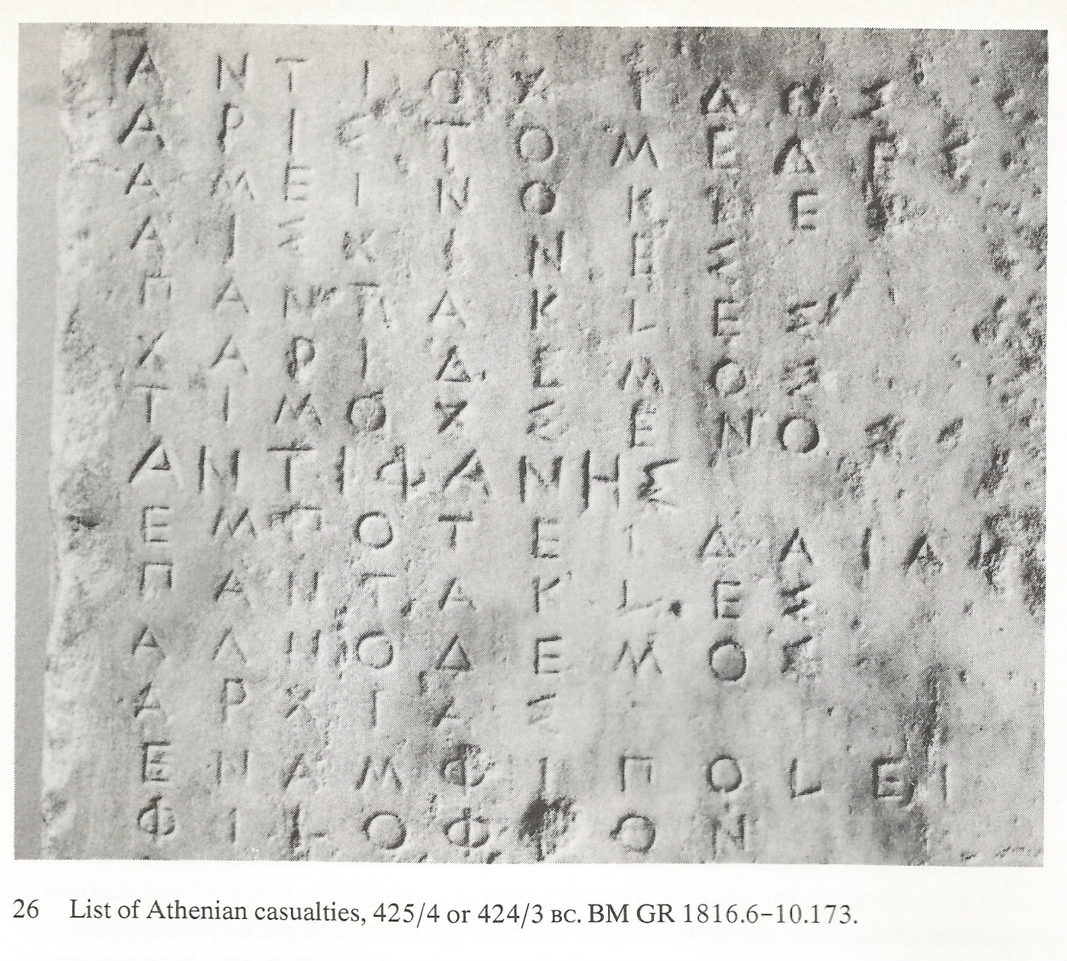
Ancient Greek for Everyone
Ἀντιόχιδος
Ἀριστομέδης
Ἀμεινοκλῆς
Αἰσχίνης
Παντακλῆς
Χαρίδημος
Τιμόξενος
Ἀντιφάνης
Notes:
BM GR 1816.6-10.173 (from B.F. Cook, Reading the Past: Greek Inscriptions [Berkeley: University of California Press, 1987] pp.34-35.

Slide 20
Ancient Greek for Everyone
ἐν Ποτειδαίᾳ
Παντακλῆς
Ἁγνόδημος
Ἀρχίας
ἐν Ἀμφιπόλει
Φιλόφρων
Notes:
BM GR 1816.6-10.173 (from B.F. Cook, Reading the Past: Greek Inscriptions [Berkeley: University of California Press, 1987] pp.34-35.

